Slide 1

ALY 6980
CAPSTONE PROJECT
Group 3: Pei-Yu Jheng, Shreeya Ambre, Sean McLean, Ted Smith
26th March 2025

Slide 2
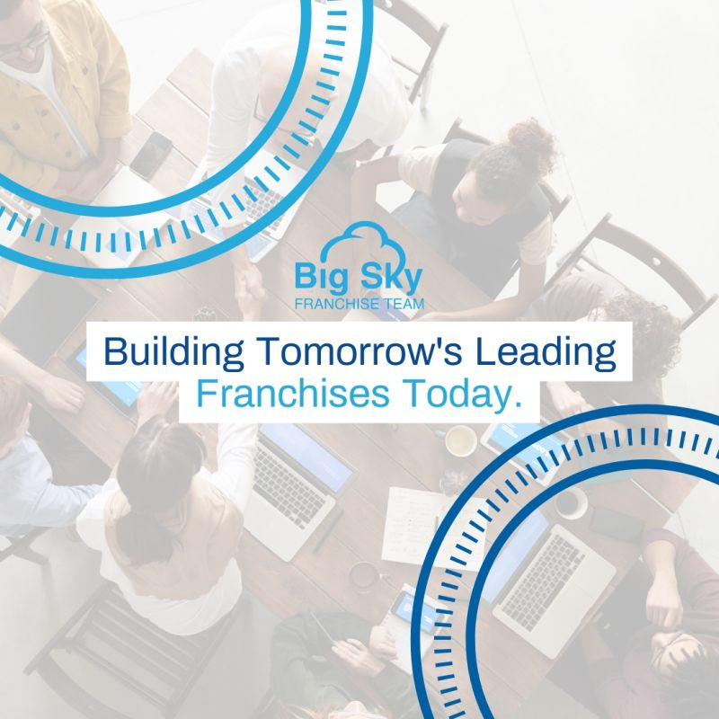
INTRODUCTION
This is a great exercise to have an open opportunity to see what we find
Areas to improve to pave the way for increased future successes
Allows Big Sky to focus on the most important factors bringing new clients

Slide 3

KEY QUESTIONS
FOCUS AREAS FOR CLIENT ACQUISITION
Our analysis will highlight key areas to focus on for landing more clients
2
STATE/REGION IMPACT
Do certain states or regions influence the number of inquiries and probabilities in the dataset?​
​

Slide 4
DATA PREPARATION AND ANALYSIS
Identify Trends and Patterns
Comparison with External Datasets
Examine Variable Relationships
After data cleanup and preparation, focus on key attributes to target potential clients
Evaluate similar external datasets for added insights
Examine correlations for business insights and addressing concerns
Notes:
-Duplicate Columns: Identify and distinguish 14% duplicate columns.​
Removed 33% of columns (id, pipeline) due to redundancy or repetitive patterns.​
Handle Missing values improving completeness by 28%.
-Data Governance entails quality, stewardship, protection, and management of the data provided.

Slide 5
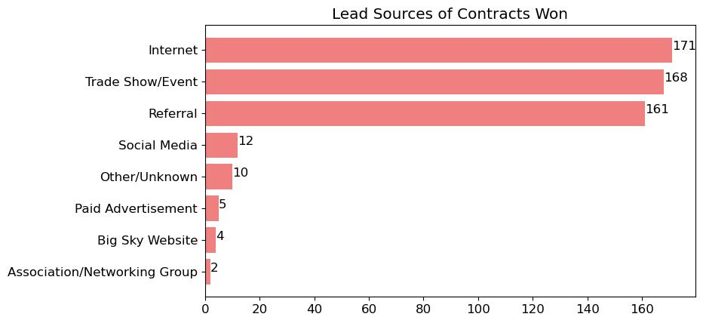
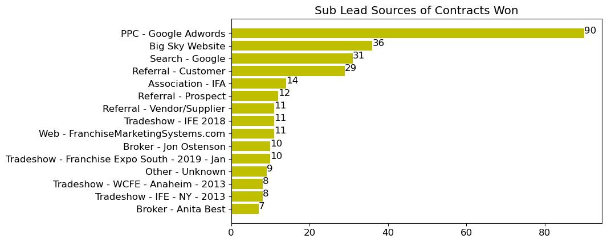
FOCUS ON THE SUCCESS
But break out the details in the Sub Leads
Notes:
We are going to start from focus on Big Sky’s success, about which lead source has the most customers who have successful transactions with Big Sky
they are mainly from internet, trade show/event, and referral
We also breaks down the details in the sub leads
The top 5 events attract deals success customers are Google Adwords, Big Sky Website, Google Search, Referral - Customer, and International Franchise Association

Slide 6
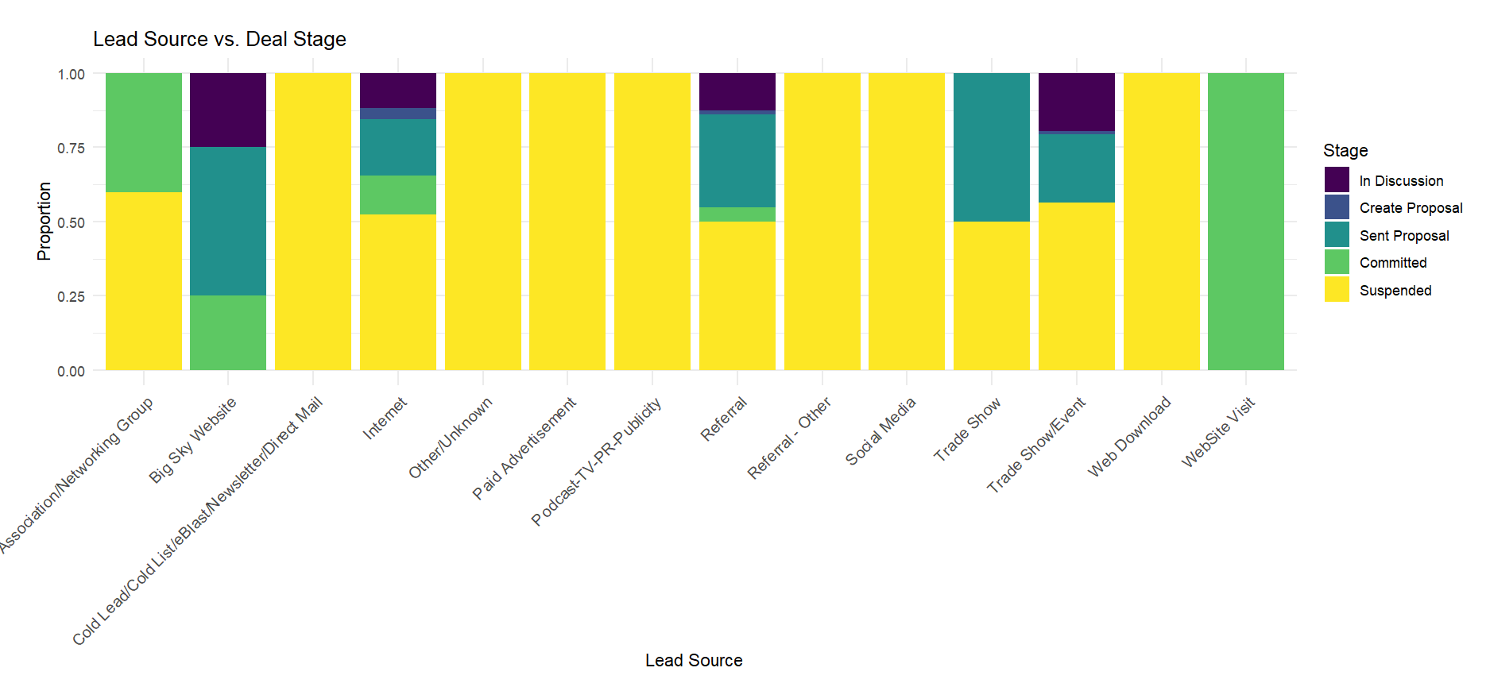
LEAD SOURCE VERSUS INITIAL DEAL STAGES
No suspensions when going through the Big Sky website!
Several lead sources have 100 percent suspension rates.
Notes:
When we look at the lead source versus initial deal stages,
We can see that the Lead source effectiveness varies dramatically across Big Sky’s sales pipeline
The Big Sky website stands out as the most effective channel, with zero suspensions and high commitment rates
Several lead sources (Cold lead, Unknown, Paid Advertisement, Podcast, Social Media, and Web Download) show 100% suspension rates, indicating these channels aren't progressing deals forward
The priorities should be:
Focus on lead sources that work in the future and how to improve closing rates for lead sources that are getting past suspensions.

Slide 7
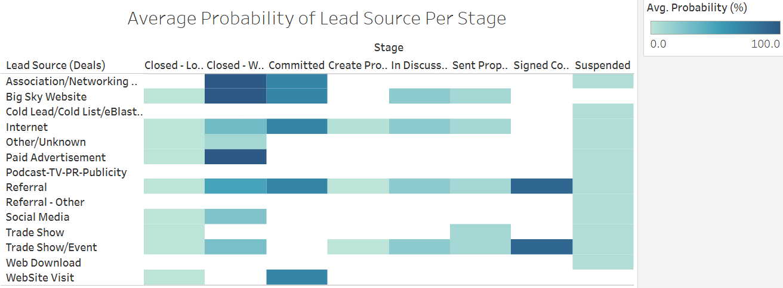
WHICH LEAD SOURCES PROGRESS THE MOST?
Notes:
Based on this heat map, we can analyze which lead sources progress most effectively through Big Sky’s sales pipeline:
- Internet, Trade Shows, and Referral all go through each stage and have moderate to high closing probabilities.
- Big Sky Website has high commitment and closing rates.
- All podcasting and cold leads sources lead to suspensions.
- Other website visits have high commitment rates but don’t lead to closing deals.

Slide 8
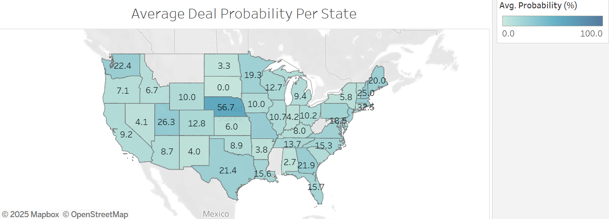
WHERE DEALS ARE MOST EFFECTIVE NATIONALLY
Notes:
-Top 5 states by total clients (Florida, Georgia, Texas, California, and Illinois) have high to moderate deal probabilities.
-Some states have high deal probabilities but have small sample sizes.
-Clusters of high to moderate deal probabilities in the Midwest, South, and Northeast.

Slide 9
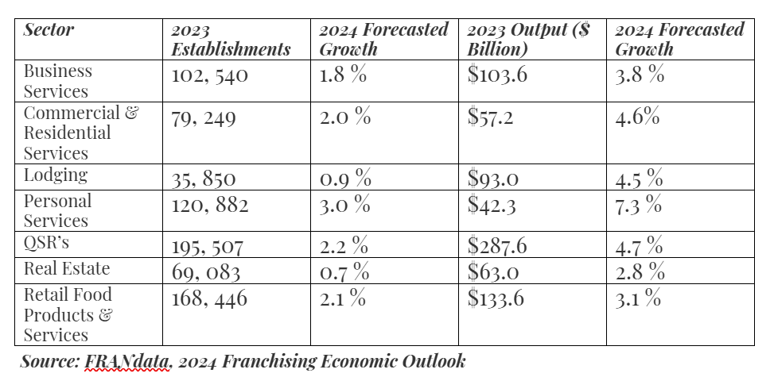
FRANCHISING OVERVIEW
2.2 % Overall Growth in Franchising Industry.
Overall increases in 2024 Forecasted Growth.
Consumer behaviors impacting key sectors for 2024 predictions. (Barraan, J, 2024).
Notes:
2.2 % Overall Growth in franchising industry despite concerns over inflation and supply chain disruptions.
2024 Forecasted Growth shows overall increases in total establishments (1.9 %) and total franchise output (4.1 %).
Key sectors in 2024 predictions that have been impacted by consumer behaviors include personal services, quick service restaurants, and commercial & residential services. (Barraan, J, 2024).

Slide 10
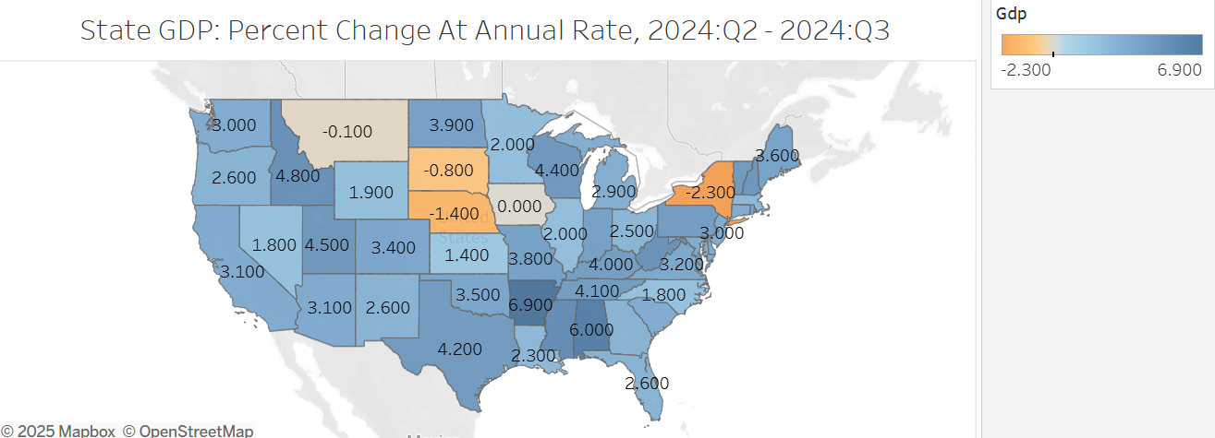
Stronger regions in the southeast, especially in Alabama, Arkansas, and Tennessee.
Parts of the Midwest and New York show negative returns for the quarter.
How can these recent number affect approaches toward franchising deals in the future?
Notes:
In economics, Gross Domestic Product (GDP) is the total monetary value of all final goods and services produced within a country's borders during a specific period, typically a year, and is a key indicator of a nation's economic health.
Franchising significantly impacts the economy by supporting GDP through billions in products, services, and payroll, creating jobs, and contributing to local economies through tax revenue and community involvement.

Slide 11
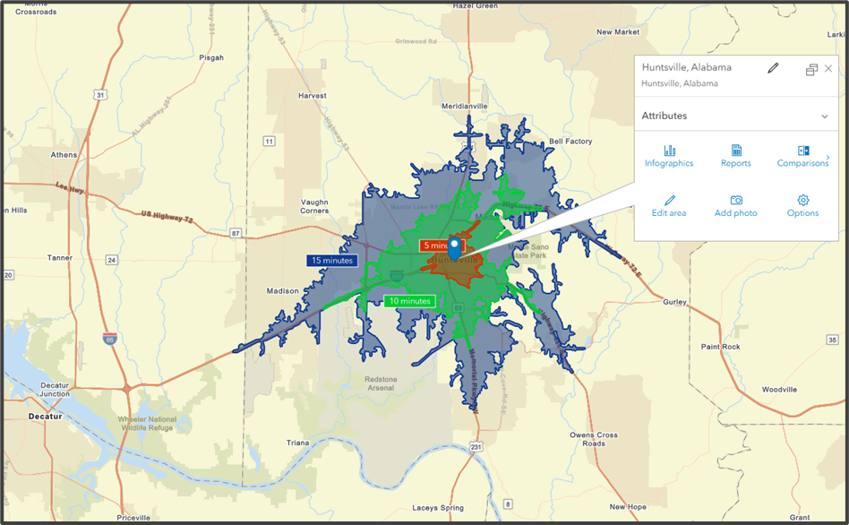
Huntsville, AL

Slide 12
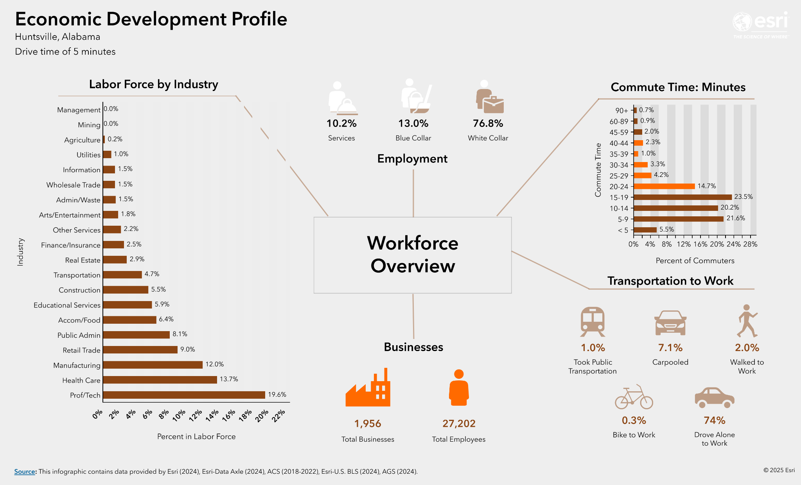

Slide 13
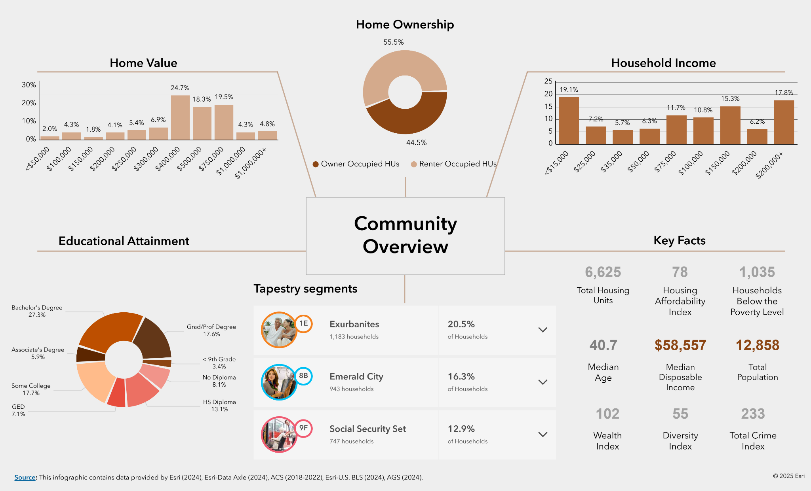

Slide 14
NEXT STEPS
Designing Customer Management Accounts
Data Collection methods to gain important metrics
Creating interactive dashboards for data insights
Presenting a plan and solution for long term growth
01
02
03
04

Slide 15

Thank You!

